Slide 1

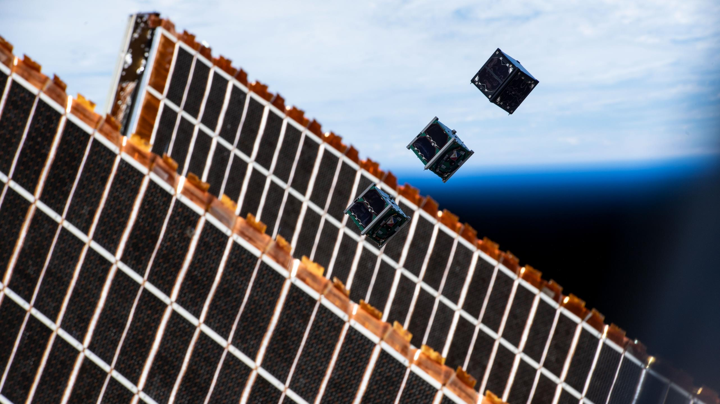



SCHOOL HOLIDAY
PROGRAM SUMMER 2024

Slide 2
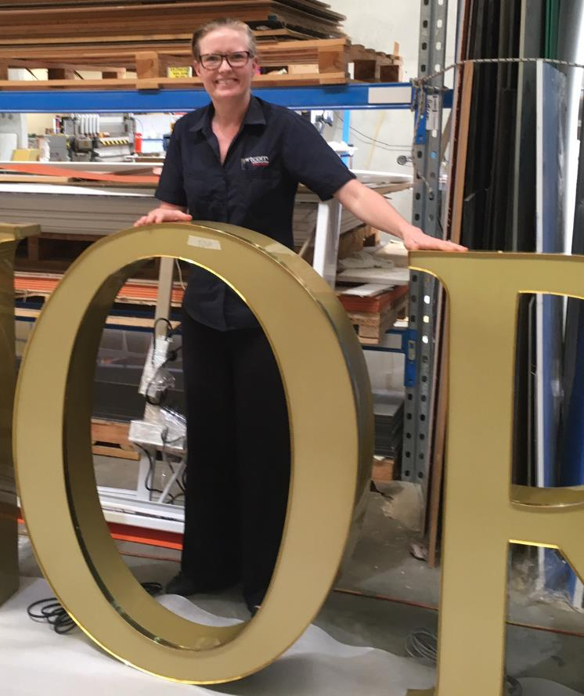
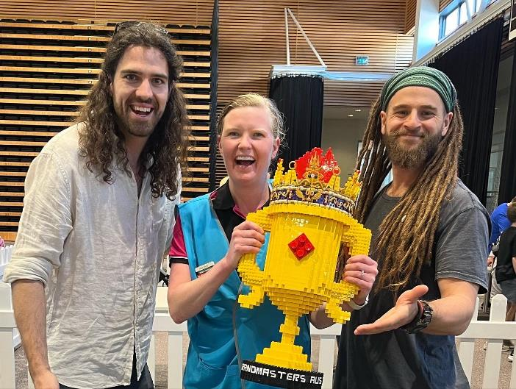
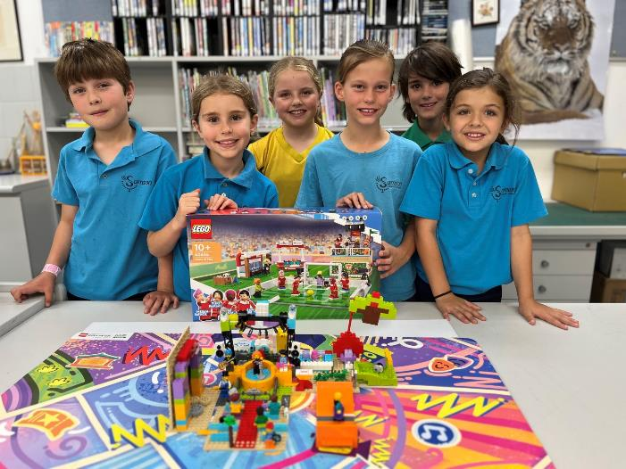
MEET YOUR INSTRUCTORS \ MEG
BinarX Outreach Program Co-Ordinator, Curtin University
Graphic Designer / Manufacturing Sector Project Manager
LEGO Enthusiast – led me to becoming a FIRST LEGO League Volunteer & Coach
Aspiring LEGO Master ☺
Notes:
What is BinarX?
The BinarX Outreach Program is a high school outreach program that empowers WA students to design and build payloads for low-Earth orbit on board Binar CubeSats
We have grown from 3 groups (encompassing 5 schools) to 11 groups (encompassing 13 schools), but will cap participation at 8 schools or groups as we have more demand for the program than we can currently service.
We will also be running the school holiday program building payloads on Rob Howie’s custom PCBs and launching them in rockets that the students build and customise with 3D printed nose cones, which currently has 11 confirmed enrollments with students from 6 different schools or school groups across WA. 2 of these schools are not yet participating in the BinarX 2024 program so we expect the interest for participation to continue to grow.

Slide 3
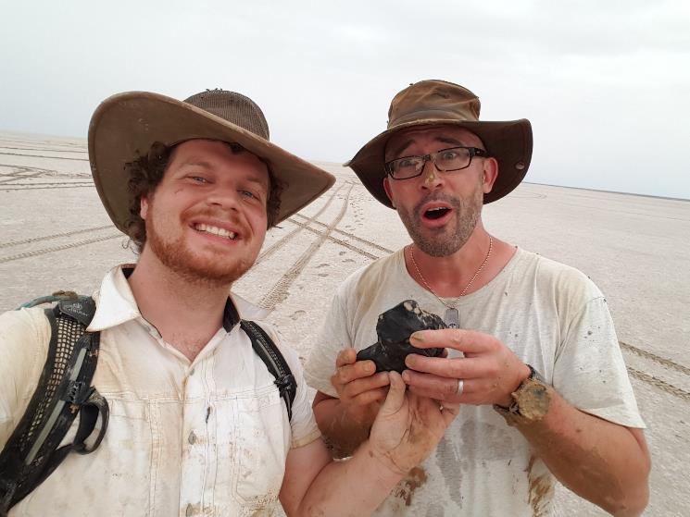
MEET YOUR INSTRUCTORS \ ROBERT
Researcher and Lecturer at Curtin University
Engineer working on spacecraft systems and planetary science projects including the Desert Fireball Network.
Designed the Desert Fireball Network Observatory for my PhD
Teach Curtin's spacecraft technology units for engineering and science students.
Notes:
What is BinarX?
The BinarX Outreach Program is a high school outreach program that empowers WA students to design and build payloads for low-Earth orbit on board Binar CubeSats
We have grown from 3 groups (encompassing 5 schools) to 11 groups (encompassing 13 schools), but will cap participation at 8 schools or groups as we have more demand for the program than we can currently service.
We will also be running the school holiday program building payloads on Rob Howie’s custom PCBs and launching them in rockets that the students build and customise with 3D printed nose cones, which currently has 11 confirmed enrollments with students from 6 different schools or school groups across WA. 2 of these schools are not yet participating in the BinarX 2024 program so we expect the interest for participation to continue to grow.

Slide 4
MEET YOUR INSTRUCTORS \ Will
PhD Candidate at Curtin University
Joined BINAR in 2022, to help facilitate the Summer Holiday Program! Currently Engineering Support for BINARX.
Preparing to study how to accelerate spacecraft flight computers.
Aviderage ice hockey player
Notes:
What is BinarX?
The BinarX Outreach Program is a high school outreach program that empowers WA students to design and build payloads for low-Earth orbit on board Binar CubeSats
We have grown from 3 groups (encompassing 5 schools) to 11 groups (encompassing 13 schools), but will cap participation at 8 schools or groups as we have more demand for the program than we can currently service.
We will also be running the school holiday program building payloads on Rob Howie’s custom PCBs and launching them in rockets that the students build and customise with 3D printed nose cones, which currently has 11 confirmed enrollments with students from 6 different schools or school groups across WA. 2 of these schools are not yet participating in the BinarX 2024 program so we expect the interest for participation to continue to grow.

Slide 5
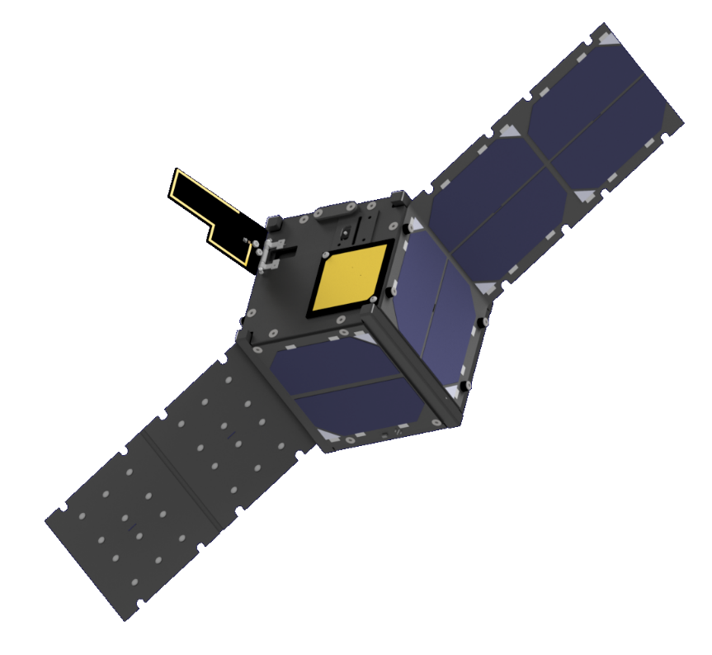
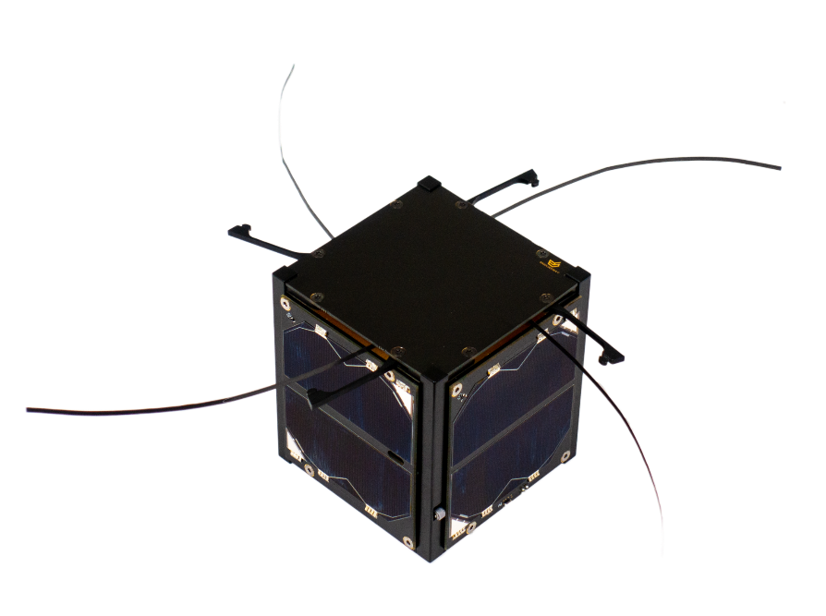
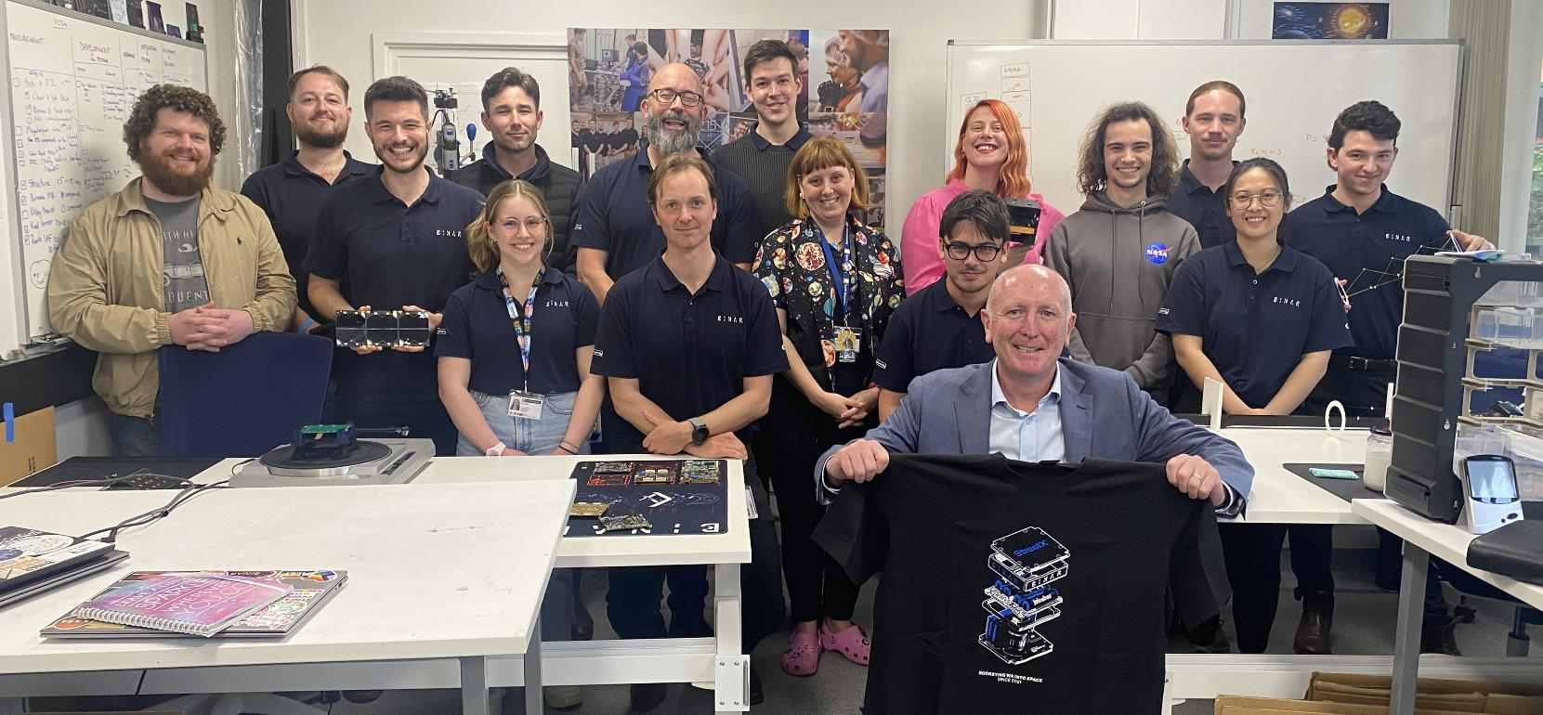
THE BINAR STORY
‘Binar’ meaning ‘fireball’ in the Noongar language
Launched WA’s first satellite in 2021
Binar-1
Binar-2,3,4
Diagram Design: Lorian Marshall
Notes:
Have Fergus talk about this (noting that he missed photo day!)

Slide 6
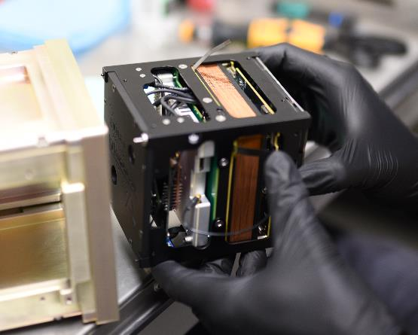
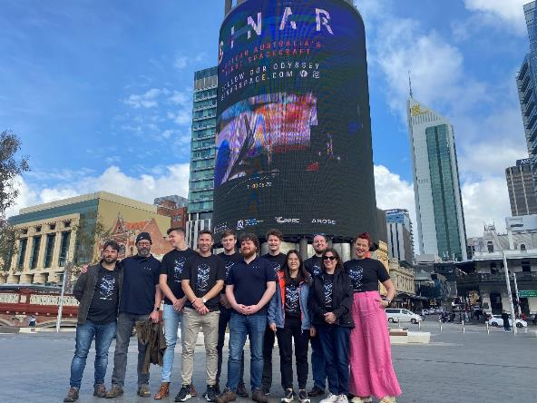
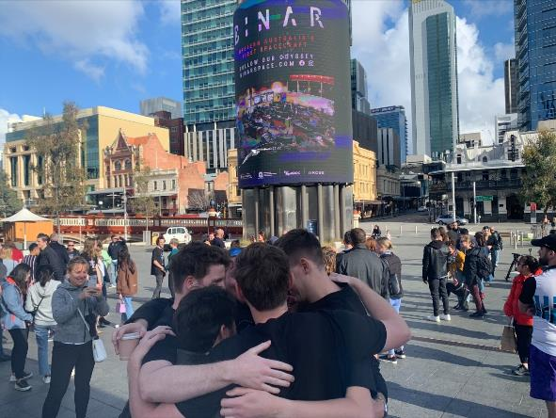
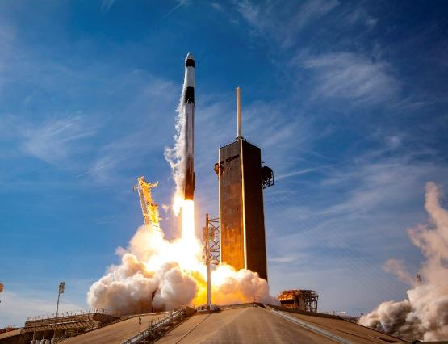
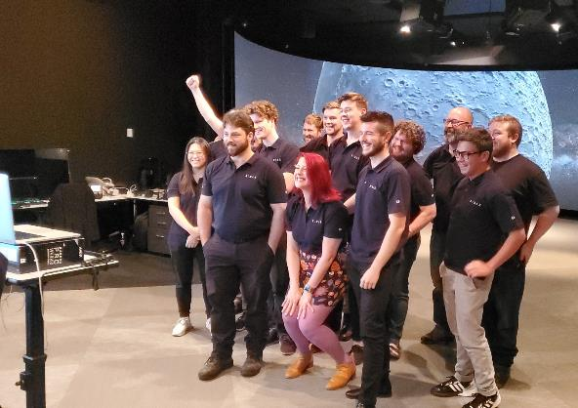
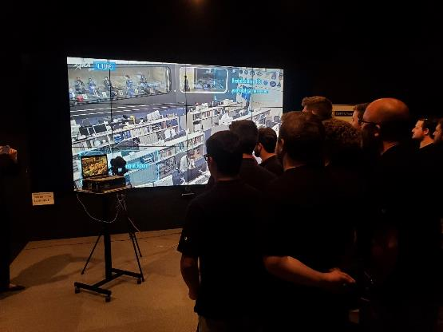
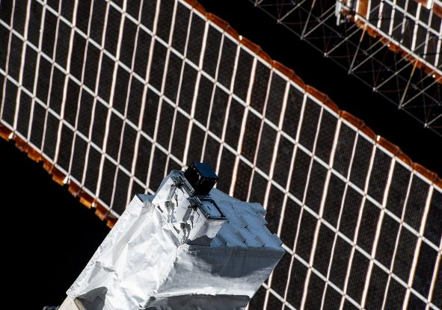
THE BINAR STORY
Notes:
Have Fergus talk about this (noting that he missed photo day!)

Slide 7
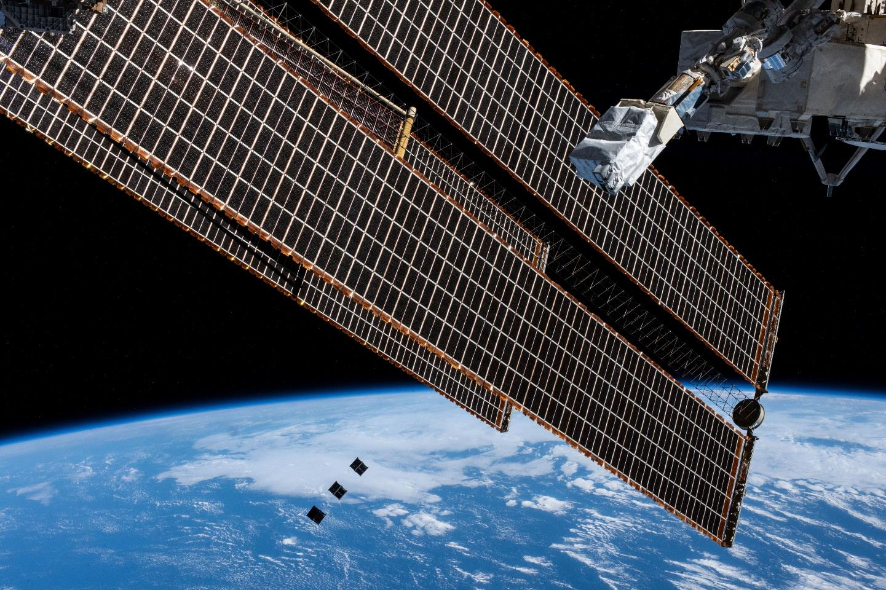
THE BINAR STORY
Notes:
Have Fergus talk about this (noting that he missed photo day!)

Slide 8
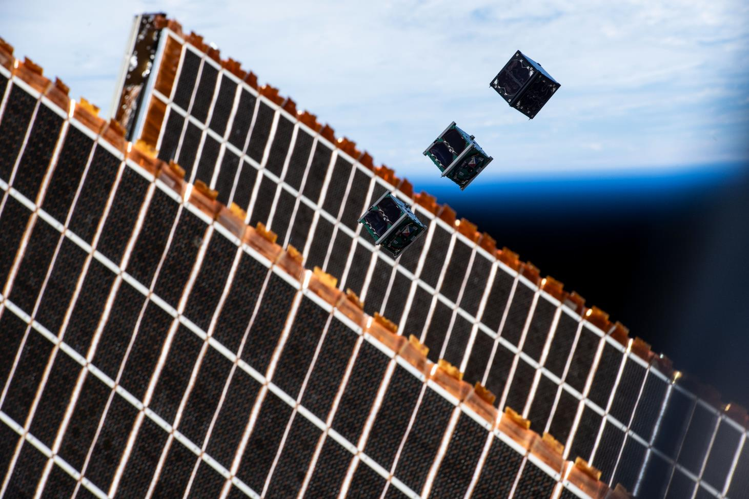
THE BINAR STORY
Notes:
Have Fergus talk about this (noting that he missed photo day!)

Slide 9
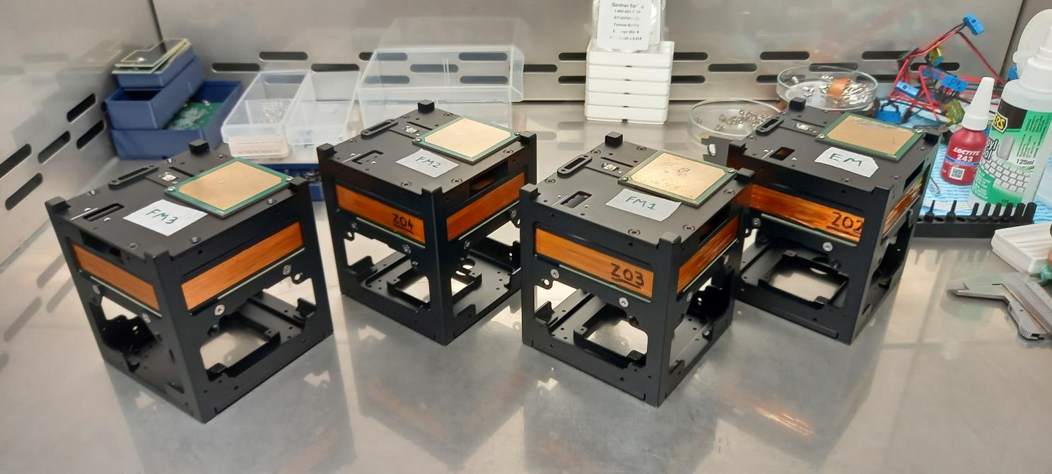
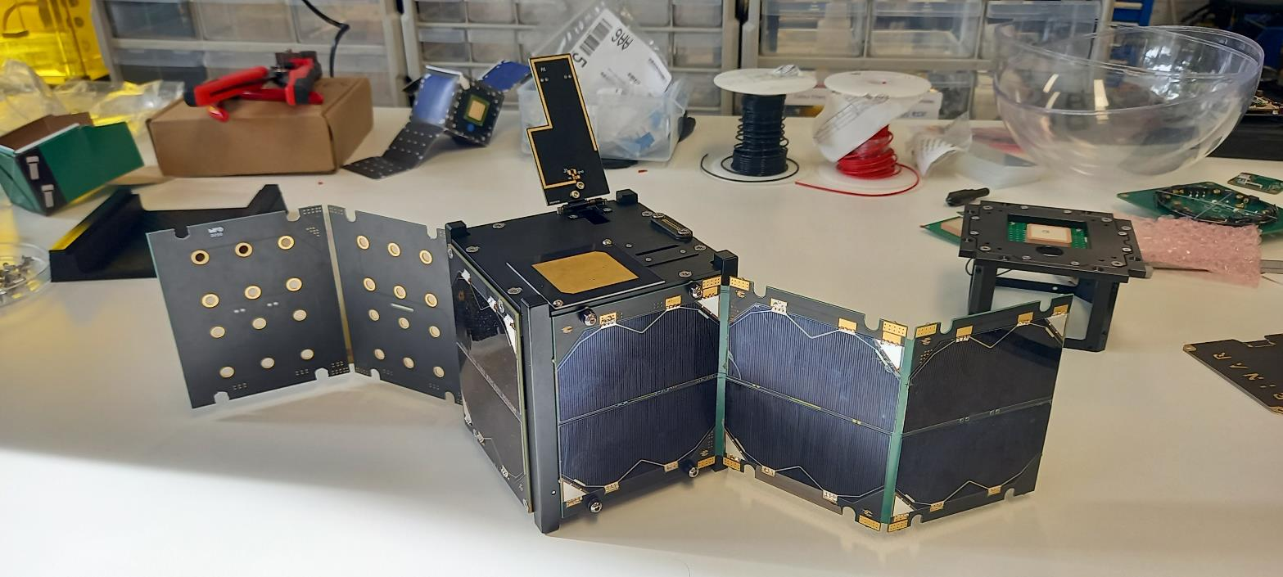
binar-2-3-4 / Premission
Notes:
Have Fergus talk about this

Slide 10
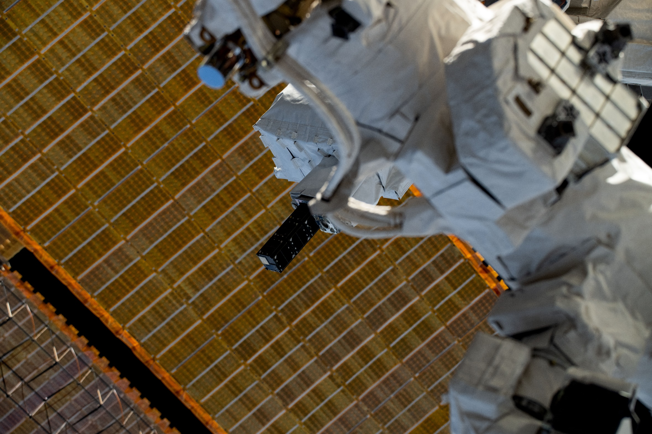
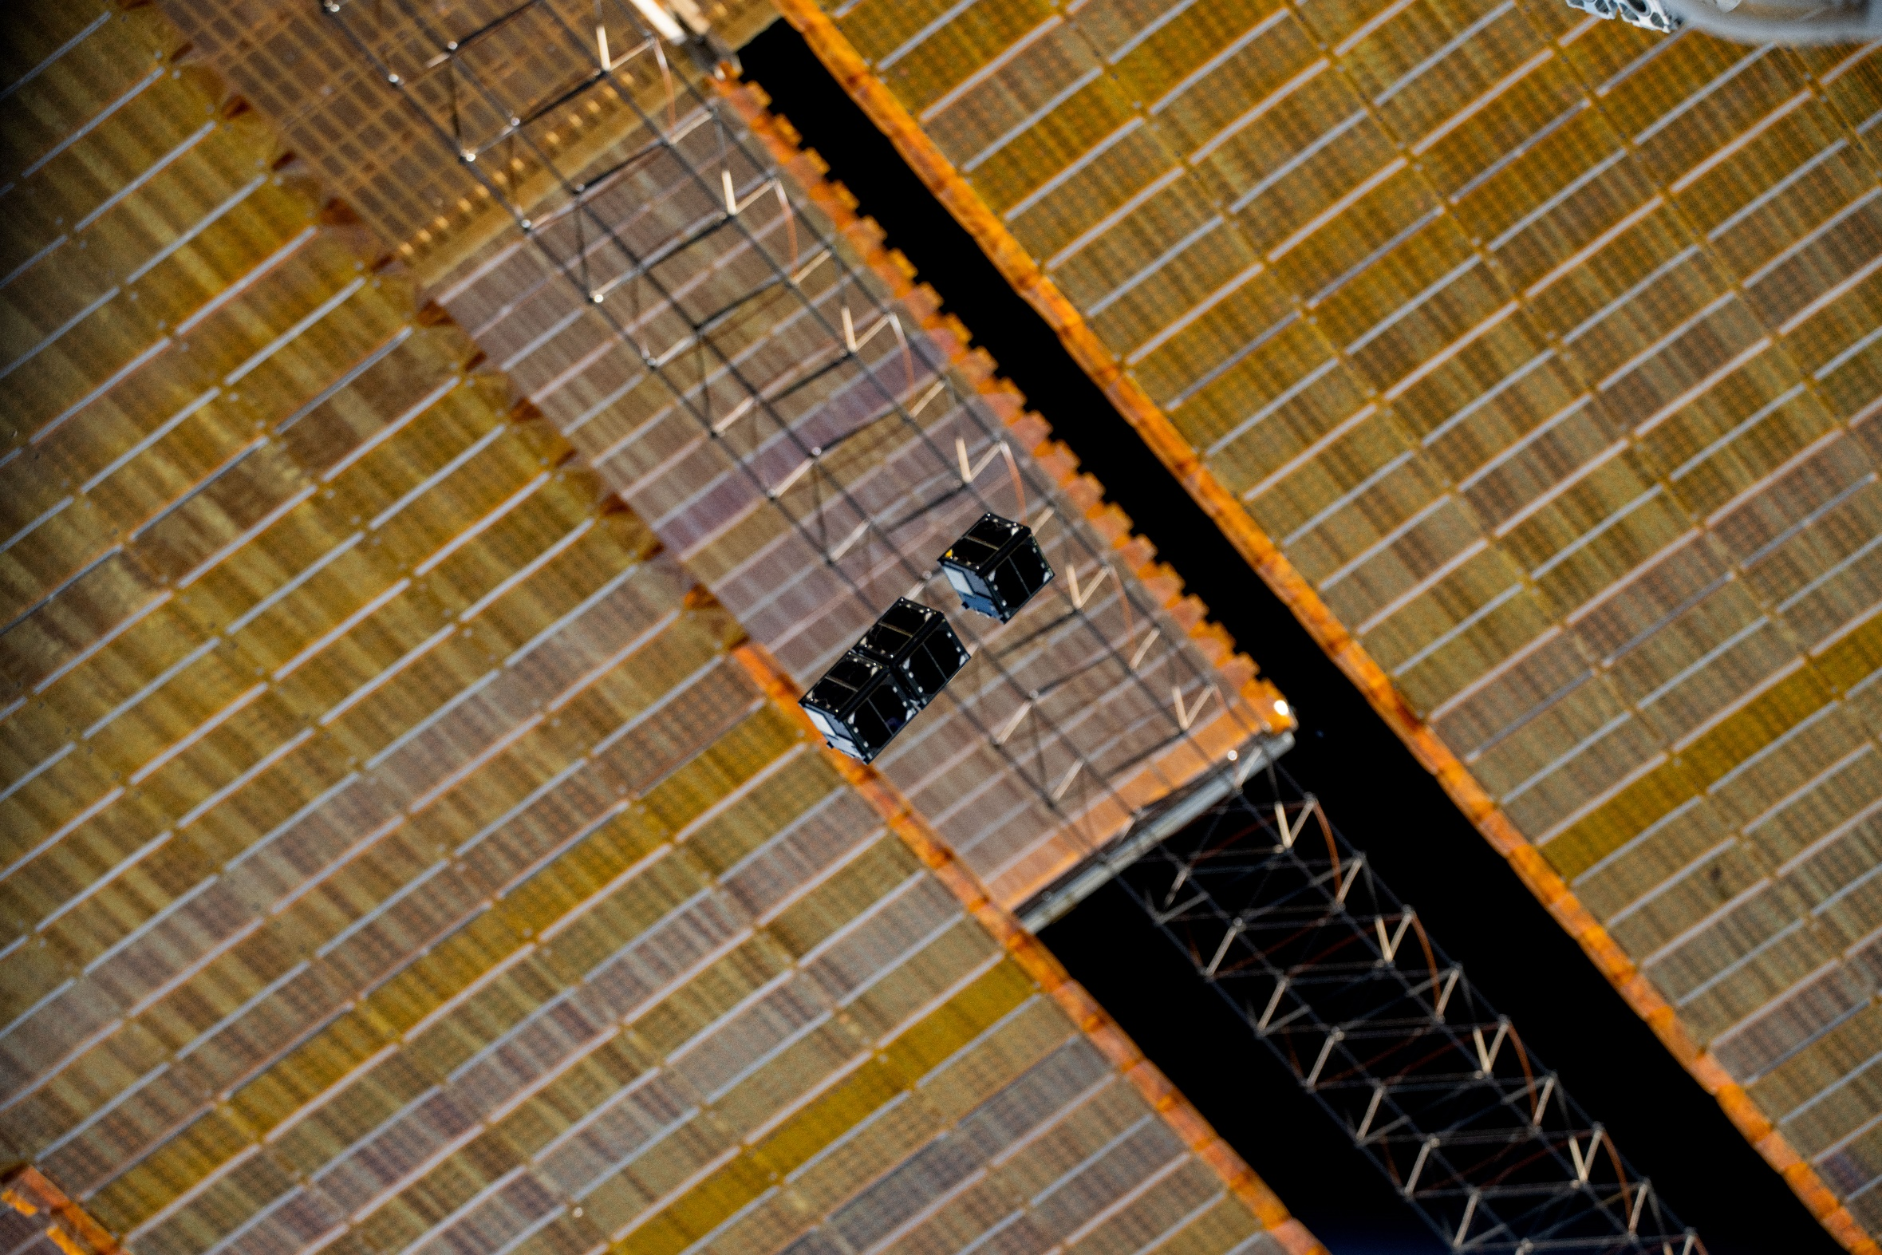
Binar 2-3-4 / Start of Mission
Notes:
Have Fergus talk about this

Slide 11

OUR MISSION
WHAT IS BINARX?
Enabling high school students to design, build and test their own payloads to be flown on Binar CubeSats
Original Slide Design: Lorian Marshall

Slide 12
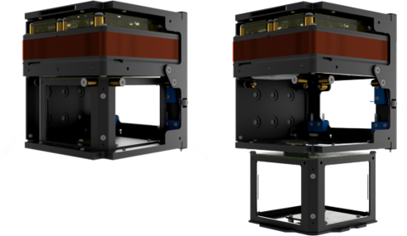
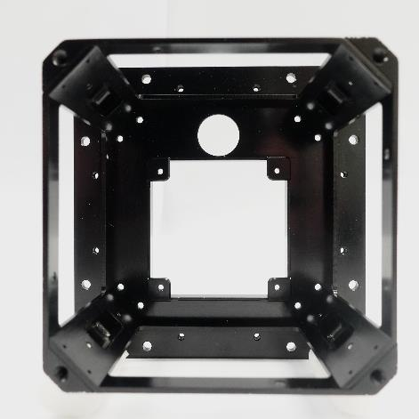
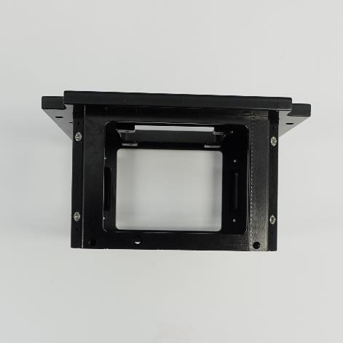
HOW WE DO THIS
In-house designed subsystems
Binar removable payload bay
Payload defined spacecraft
Original Slide Design: Lorian Marshall
Notes:
Fergus talk about this one?

Slide 13

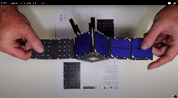
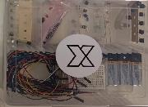
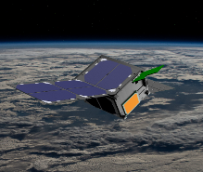
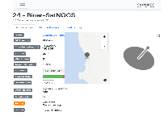
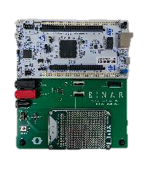
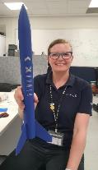

THE BINARX ECOSYSTEM
General Public
Papercraft
BinarBox
BinarX / Binarspace.com Resources
Secondary Schools
Curriculum Activities
Payload Development
Kit
School
Holiday
Programs
Amateur Radio
Ground Station
Curtin Undergraduate units
Mentoring
University
Summer Intern Program
Undergrad spacecraft team
Binar Space Program
HDR
Grad Program
SPACE SCIENCE AND TECHNOLOGY CENTRE
Original Slide Design: Lorian Marshall
Notes:
- Briefly run over renaes program structure diagram focussing in on the spacecraft lab
- You’ll learn more about the work of the amazing humans of the Space Science and Technology Centre over the next couple of weeks.
- Curtin undergrad units: AER03000 Space Systems DesignAERO3001 Spacecraft Project designed by Dr. Robert Howie are what the BInarX Payload Development Program and this school holiday program are both based directly on!

Slide 14
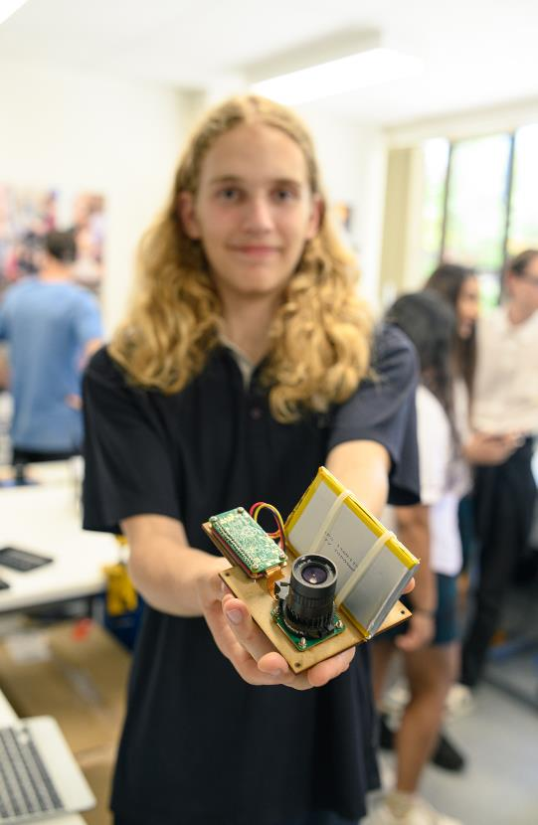
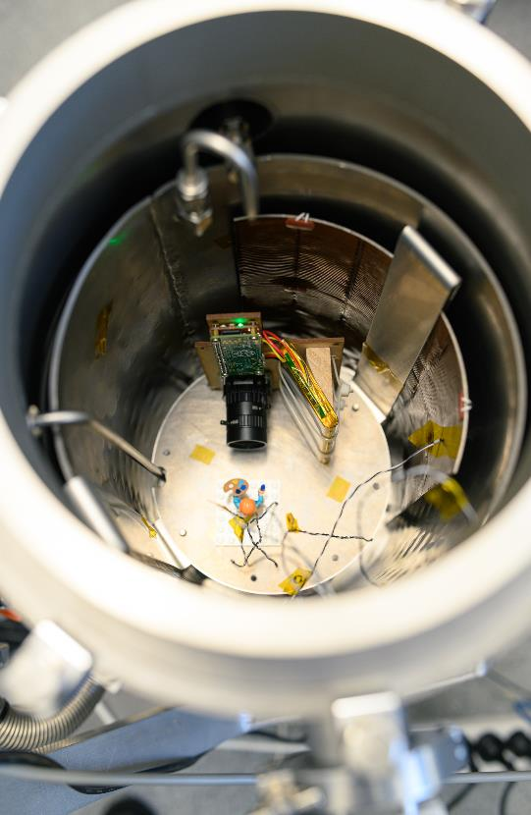
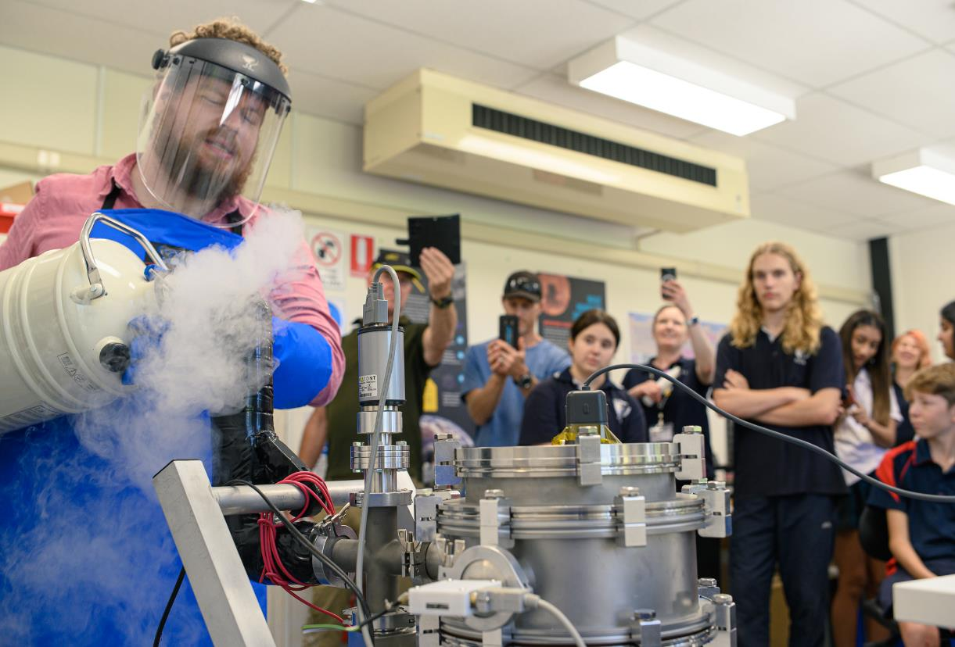
BINARX PILOT: MAKING SPACE IN SERVICE OF OTHERS
PLAQUE PRESENTATION & SPACE EVIRONMENT TESTING @ CURTIN UNIVERSITY DEC 13, 2023

Slide 15
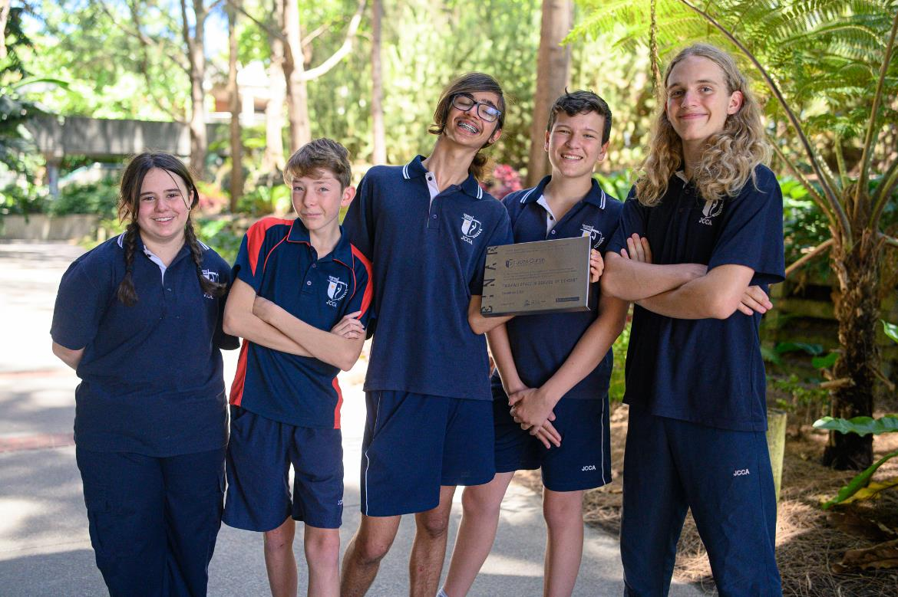
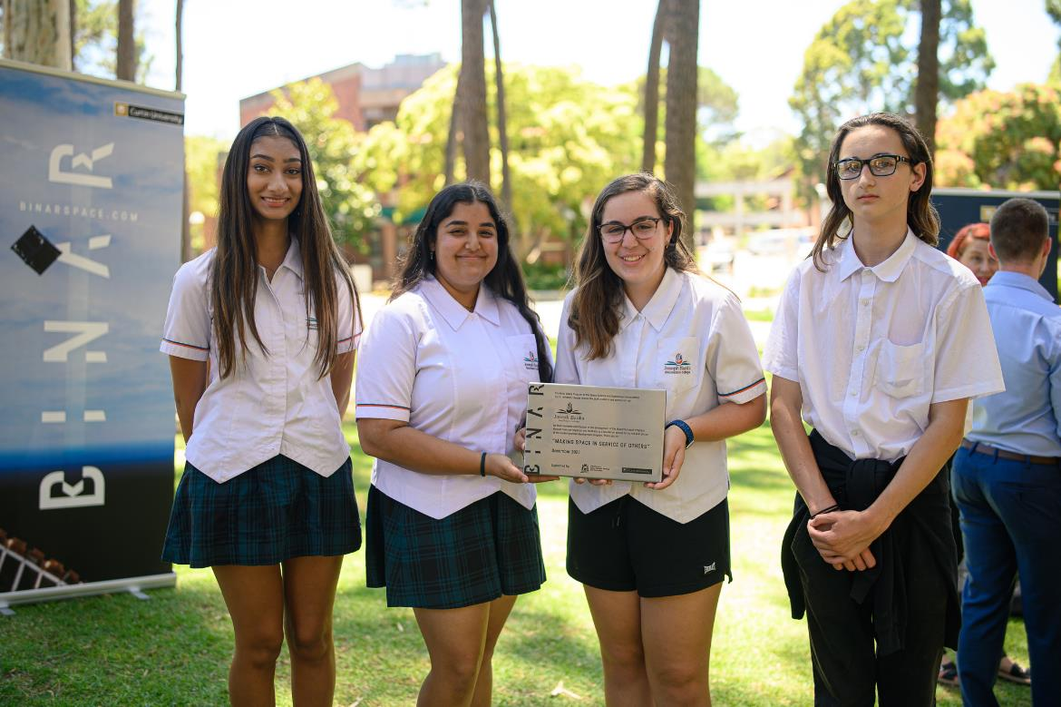
BINARX PILOT: MAKING SPACE IN SERVICE OF OTHERS
PLAQUE PRESENTATION & SPACE EVIRONMENT TESTING @ CURTIN UNIVERSITY DEC 13, 2023

Slide 16
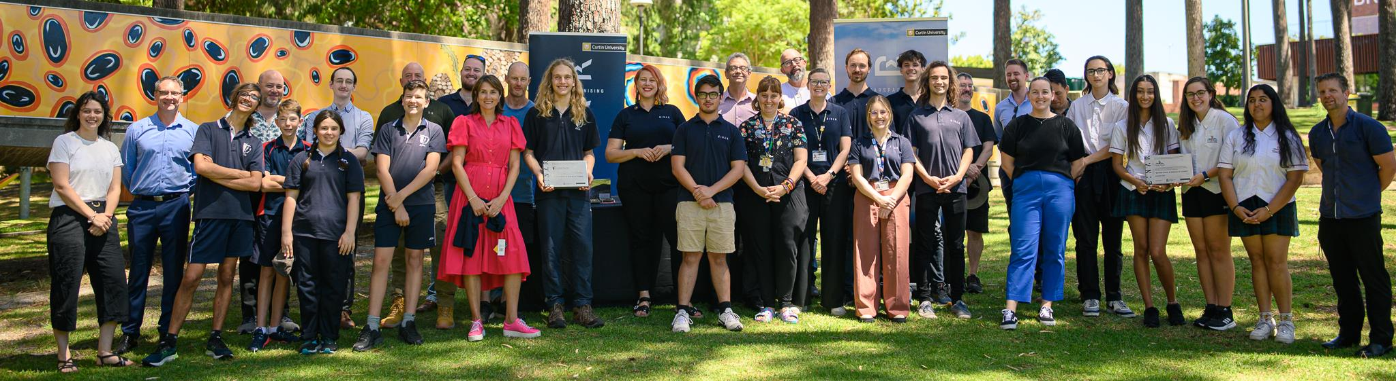
BINARX PILOT: MAKING SPACE IN SERVICE OF OTHERS
PLAQUE PRESENTATION & SPACE EVIRONMENT TESTING @ CURTIN UNIVERSITY DEC 13, 2023

Slide 17
SCHOOL HOLIDAY PROGRAM SUMMER 2024
DURING THIS 10 DAY PROGRAM YOU WILL:
Build a model rocket (one rocket each)
In a team of 3+, build a payload (instrument) to record data during the flight of your model rocket.
Design & create awesome team t-shirts (optional but recommended!)
Launch your rocket and collect data from the flight (parents and friends are welcome!)
Make and present a poster communicating the results of your project
Notes:
You’ll also use software to model or predict your rocket’s trajectory, and subject your payload to launch simulation conditions on the vibration table. We’ll do thermal vacuum testing too!
There will be prizes prizes prizes for standouts in categories such as most accurate modelling, best team name, tidiest code, and more! Our avionics (that’s flight hardware) engineer suggested the “magic blue smoke” award for the most components accidentally fried, but we don’t want to turn that into a competition as we have a limited number of PCBs that Rob Howie custom designed and our team – mainly our fabulous Binterns Athena, Jacob and Kieran – have been assembling by hand and we don’t want to run out ☺
You are the first students to ever do this summer holiday program, so please let us know your feedback, what you liked and what didn’t work so well so we can improve the program for future participants. The upside is you get first use of all the awesome new equipment we purchased just for this program! If there’s something you don’t understand or are feeling stuck on, we are here to help you – please don’t hesitate to put your hand up

Slide 18
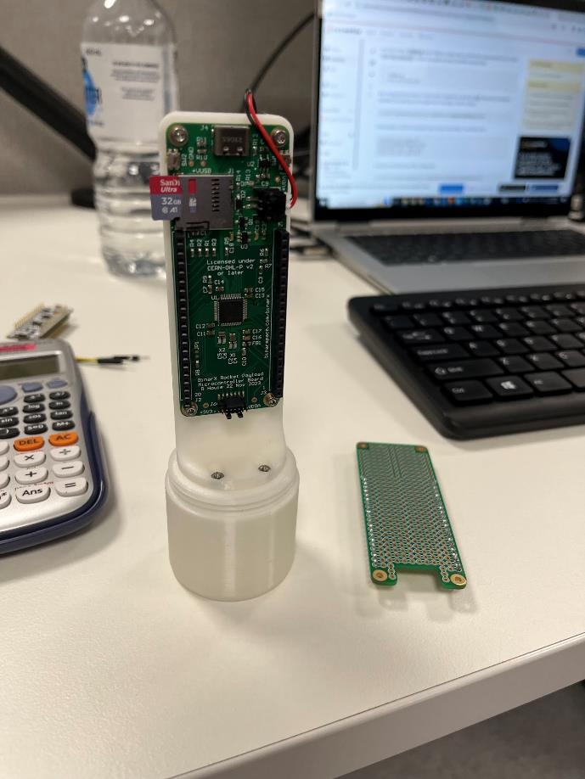
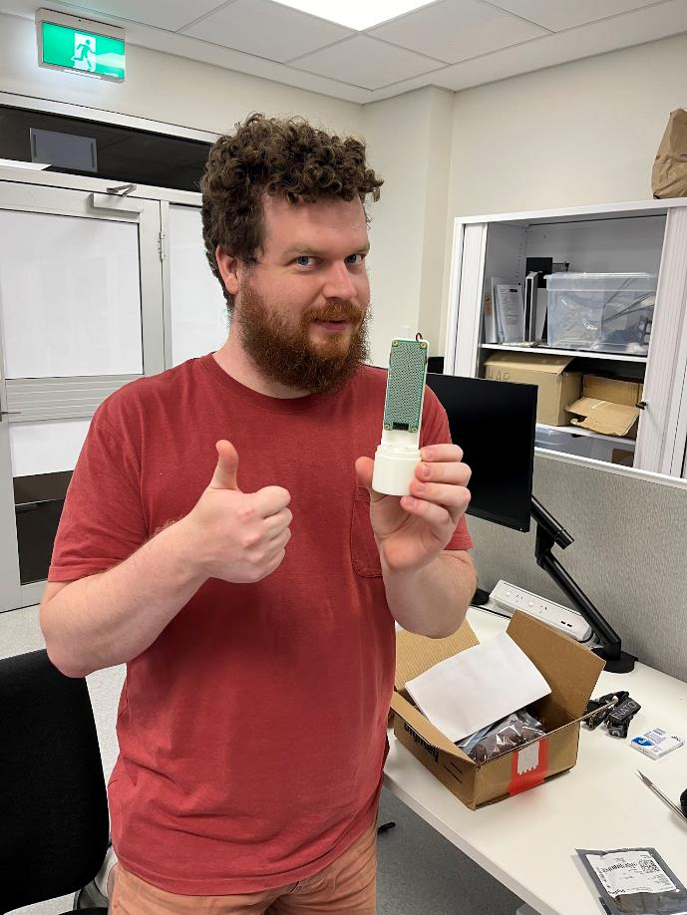
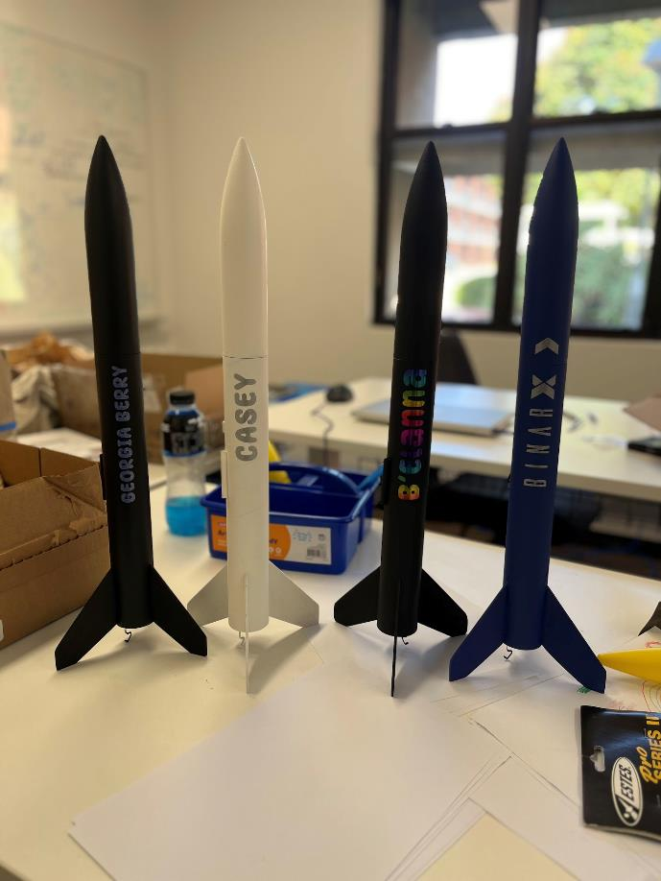
SCHOOL HOLIDAY PROGRAM SUMMER 2024
Notes:
You’ll also use software to model or predict your rocket’s trajectory, and subject your payload to launch simulation conditions on the vibration table. We’ll do thermal vacuum testing too!
There will be prizes prizes prizes for standouts in categories such as most accurate modelling, best team name, tidiest code, and more! Our avionics (that’s flight hardware) engineer suggested the “magic blue smoke” award for the most components accidentally fried, but we don’t want to turn that into a competition as we have a limited number of PCBs that Rob Howie custom designed and our team – mainly our fabulous Binterns Athena, Jacob and Kieran – have been assembling by hand and we don’t want to run out ☺

Slide 19
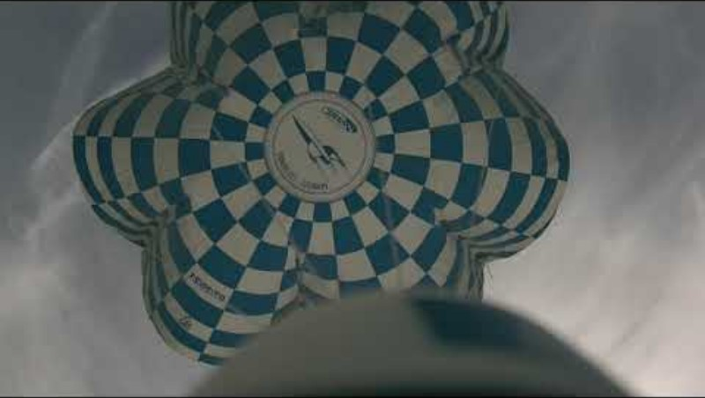
SCHOOL HOLIDAY PROGRAM SUMMER 2024
Notes:
You’ll also use software to model or predict your rocket’s trajectory, and subject your payload to launch simulation conditions on the vibration table. We’ll do thermal vacuum testing too!
There will be prizes prizes prizes for standouts in categories such as most accurate modelling, best team name, tidiest code, and more! Our avionics (that’s flight hardware) engineer suggested the “magic blue smoke” award for the most components accidentally fried, but we don’t want to turn that into a competition as we have a limited number of PCBs that Rob Howie custom designed and our team – mainly our fabulous Binterns Athena, Jacob and Kieran – have been assembling by hand and we don’t want to run out ☺

Slide 20
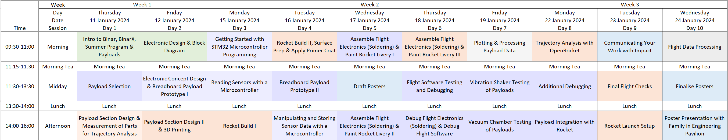
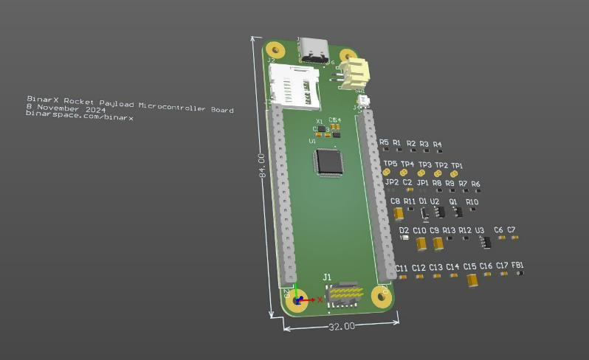
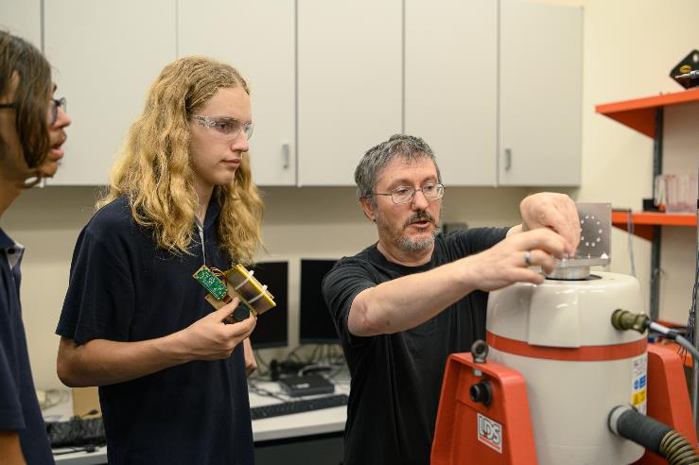
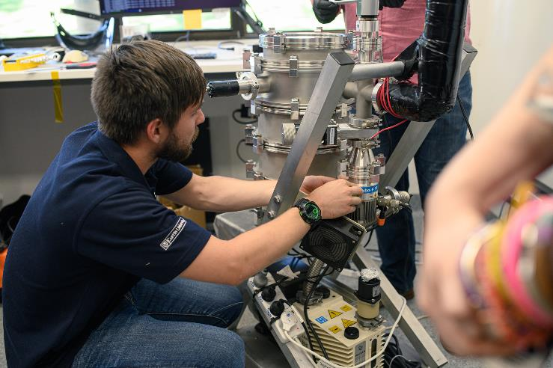
SCHOOL HOLIDAY PROGRAM SUMMER 2024
Notes:
So here is the overall program for our days. On your handout you can see that Jan 23rd from 4-6pm is the rocket launch with family. Please invite your family and friends along! The airspace over Curtin University is controlled from 400ft above ground level due to flight paths, so we have gotten a NOTAM (or NOtice To AirMen) in place from CASA and permission has been given by the Perth Tower air traffic control to launch our rockets from campus. On the day, we may need to resdchedule if: a) there is a total fire ban in place, b) it’s too windy (more than 20mph / 32kph / 17.3knots). Alternative dates include the morning of Jan 24th from 9:30am-11am, or a week later – Jan 30 from 4pm-6pm. We won’t know until a day or two out what the forecast will be so please keep that in mind.

Slide 21
LET’s GET STARTED!
Name, Year Level, Favourite Space-Related TV Show, Movie, Song or Book.

